Slide 1
Mini Project
1. Basic Component: [10 marks]
Using the genki4k dataset, build a machine learning pipeline
that takes as an input an image and predicts:
(1) whether the person in the image is similing or not
(2) estimate the 3D head pose labels in the image
2. Advanced Component: [10 marks]
Formulate your own machine learning problem
and build a machine learning solution using the genki4k dataset
(such as labled the gender for the part of dataset and perform the classification; or conduct the cluster with K-means to find some interesting observations)

Slide 2
How will we evaluate your submission?
Conciseness in your writing (10%).
Correctness in your methodology (30%).
Correctness in your analysis and conclusions (30%).
Completeness (10%).
Originality (10%).
Efforts to try something new (10%).

Slide 3
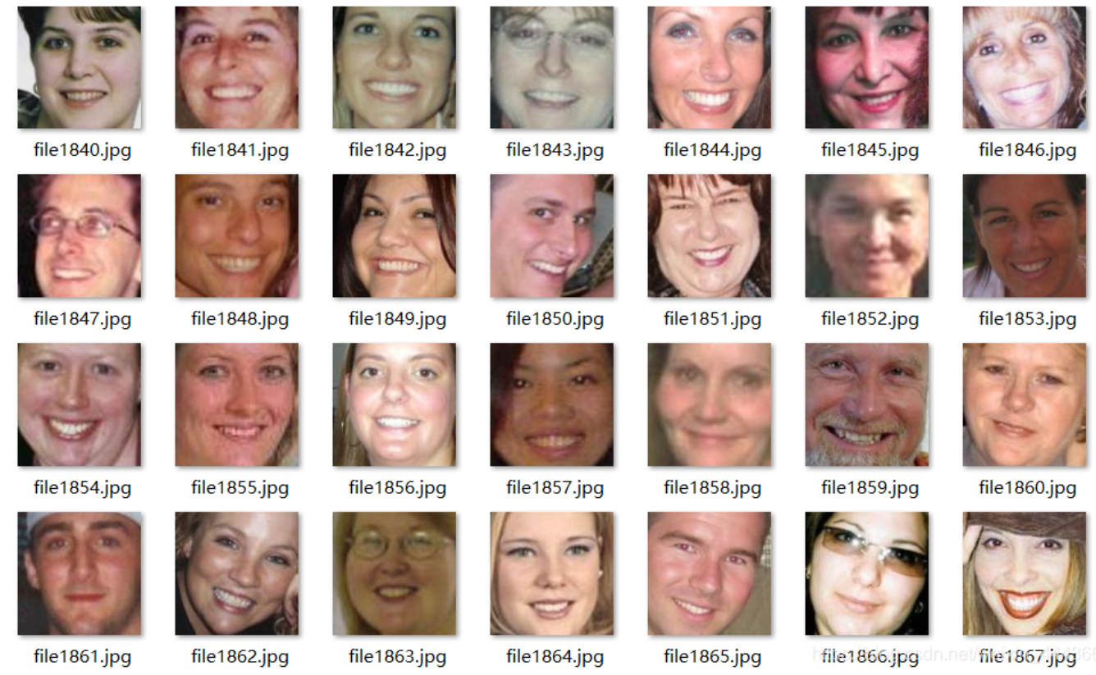
Tips
(1) Pre-Processing
(crop the human face)
(2) Split the dataset
(train/validation/test)
（60%/20%/20%）
(70%/15%/15%)
(3) Extract the feature
(CNN/SIFT....)
(4) Classification or Regression
(5) Data Normalization
and Augmentation
(6) Analyis the results

